Slide 1
Dental Office System
Shubham Mahajan 001314273
Siddhesh Juhukar 001054857
Anurag Rachcha 001375637
Rushiraj Savalia 001407983
By Group No. 7 (HellRaisers)

Slide 2
Problem Statement
Oral disease affects 3.9 billion people worldwide, with untreated tooth decay (dental caries) impacting almost half of the world’s population (44%), making it the most prevalent of all the 291 conditions included in the Global Burden of Disease Study
Globally, between 60–90% of schoolchildren and nearly 100% adults have tooth decay, often leading to pain and discomfort
In Today’s fast paced world, where convenience and accessibility is considered a mere necessity there’s a need to have a system for easy and proper management of Appointments at a Dental Office

Slide 3
INTRODUCTION :
Problem Statement
Overview
Approach
Technology Used
What’s Unique?

Slide 4
Overview
Our System aims to ease the process of scheduling and managing Appointments for the Patient at the concerned Dental Clinic.
To do the same, we gather business requirements needed for the Implementation.
The Implementation of our system involves making use of Database Management System.

Slide 5
Approach
Gathering Business Requirements
Developing the Design Document consisting of Design Areas, Business Rules, Data Model Diagram
Creating the Database on mySQL workbench
Implementing the front end using JSP servlets and connecting it to backend on MySQL using JDBC

Slide 6
Technology Used
JSP Servlets
JDBC – Java Database Connectivity
MySQL Workbench
Eclipse (IDE)

Slide 7
What’s Unique?
Implemented the front-end to database connectivity ourselves over using WAMP server
We generate a calculated invoice from a completed appointment using PROCEDURE using CURSOR.
Patient Tooth History is maintained. In that status of patient’s each tooth is handled with the help of flag. The flag will have value ‘Y’ if that particular tooth present for the patient otherwise it will have value ‘N’. For each patient there will be 32 or 20 entries in the table ‘Patient Tooth History’ based on the patient_type of Patient table i.e A=Adult or C=Child.

Slide 8
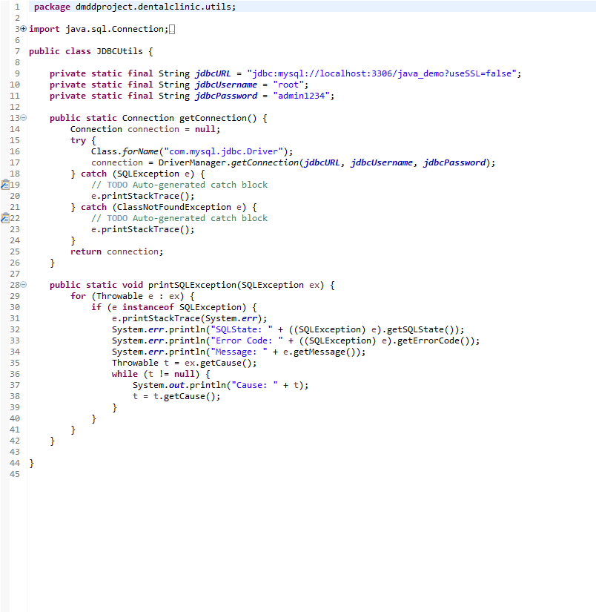
Java-MySql Connectivity

Slide 9
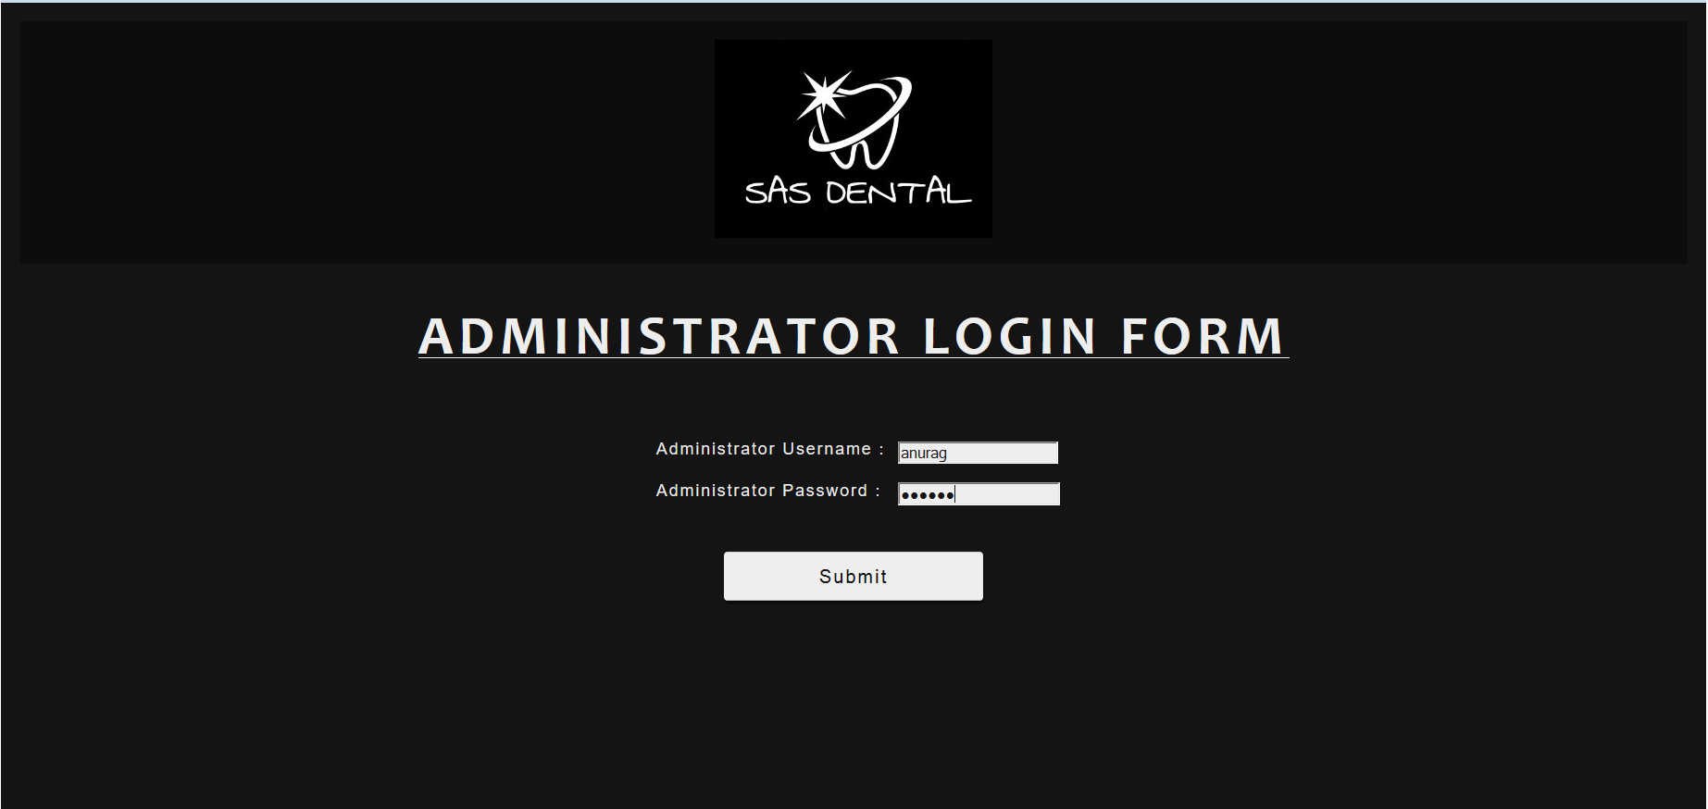

Slide 10
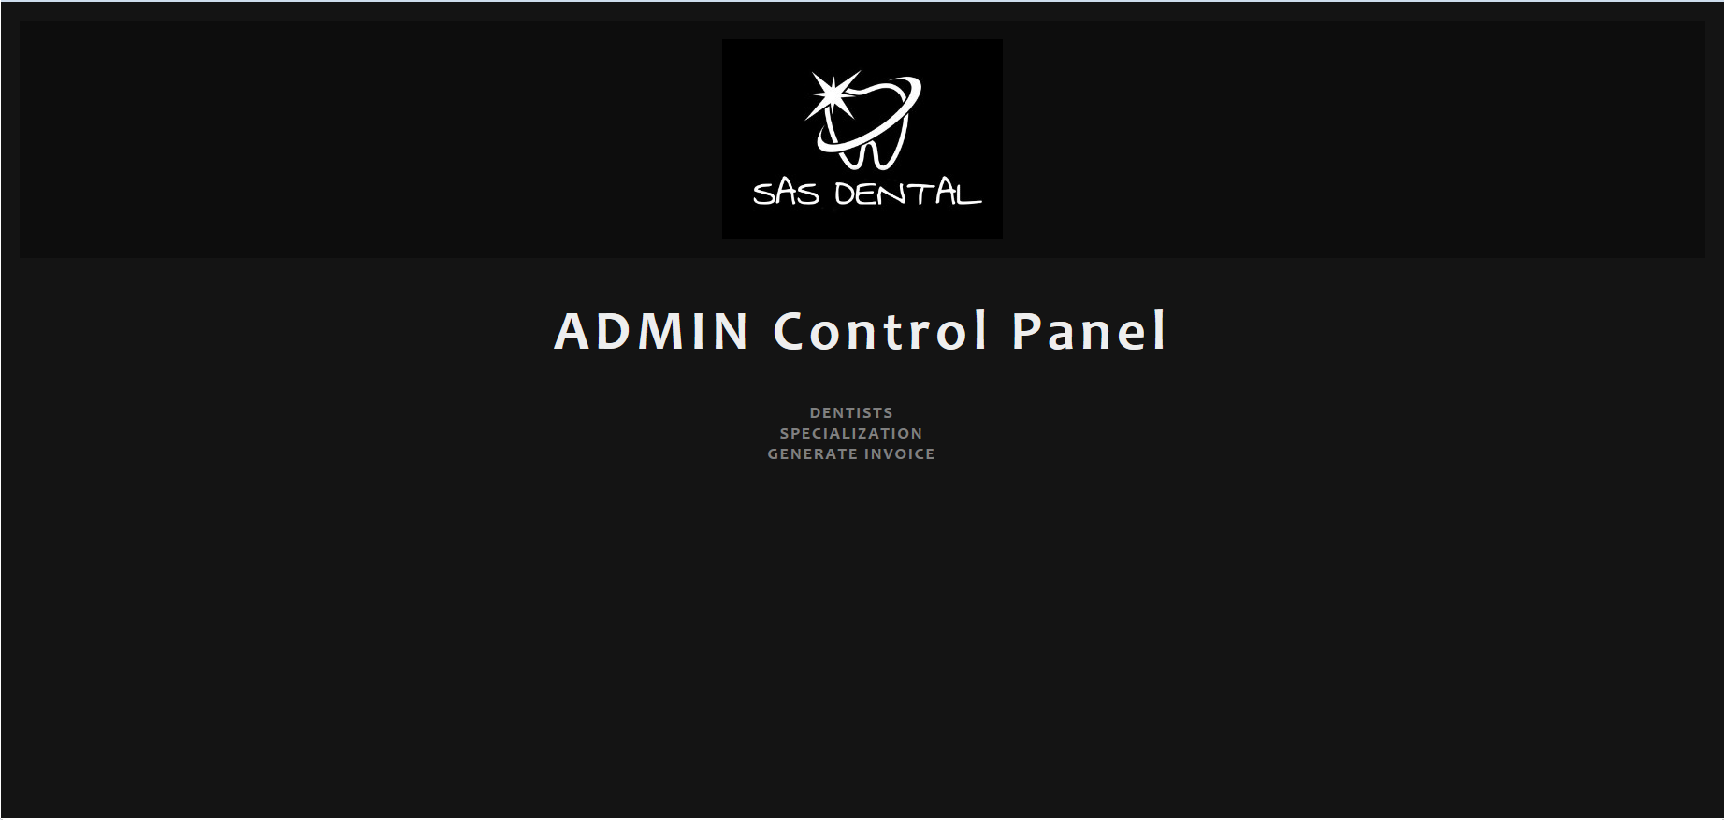

Slide 11
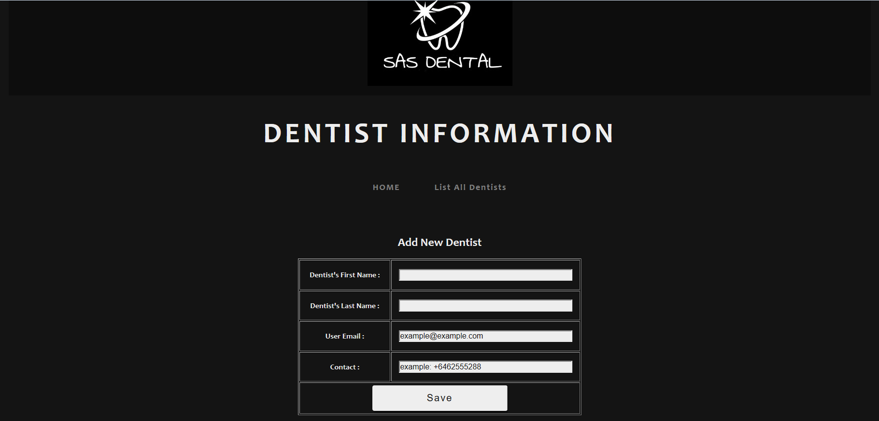

Slide 12
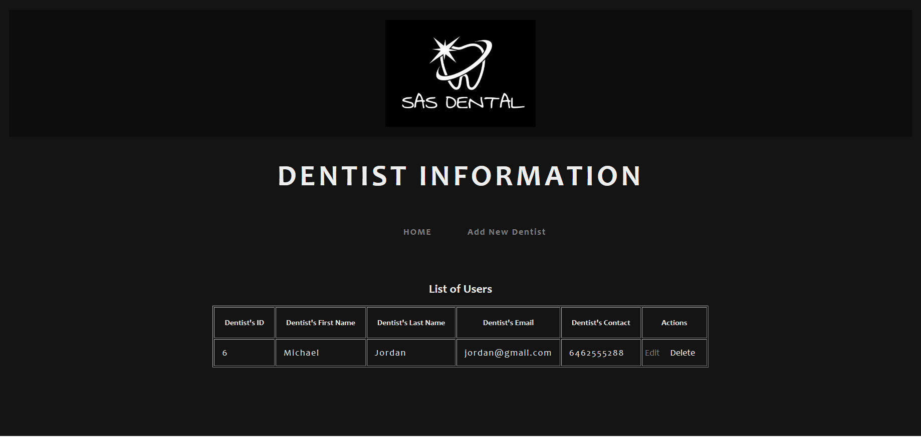

Slide 13
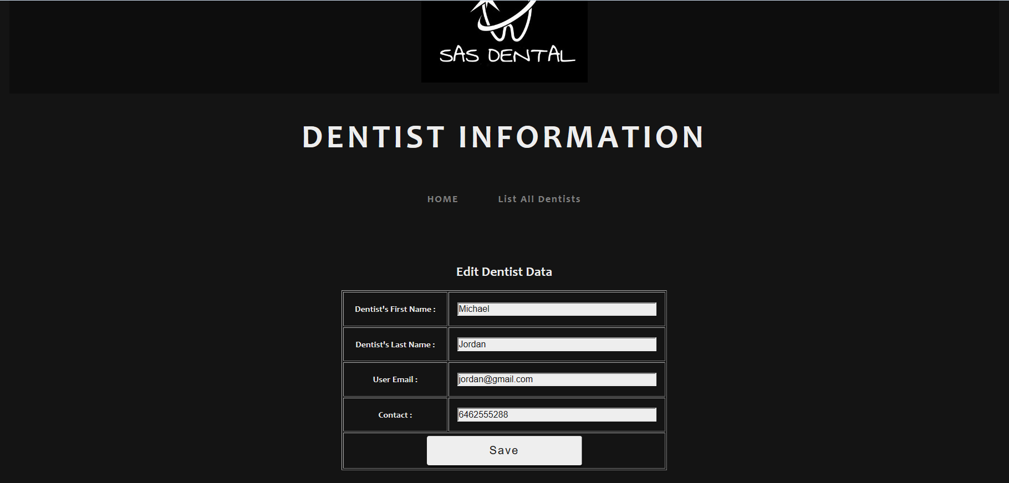

Slide 14
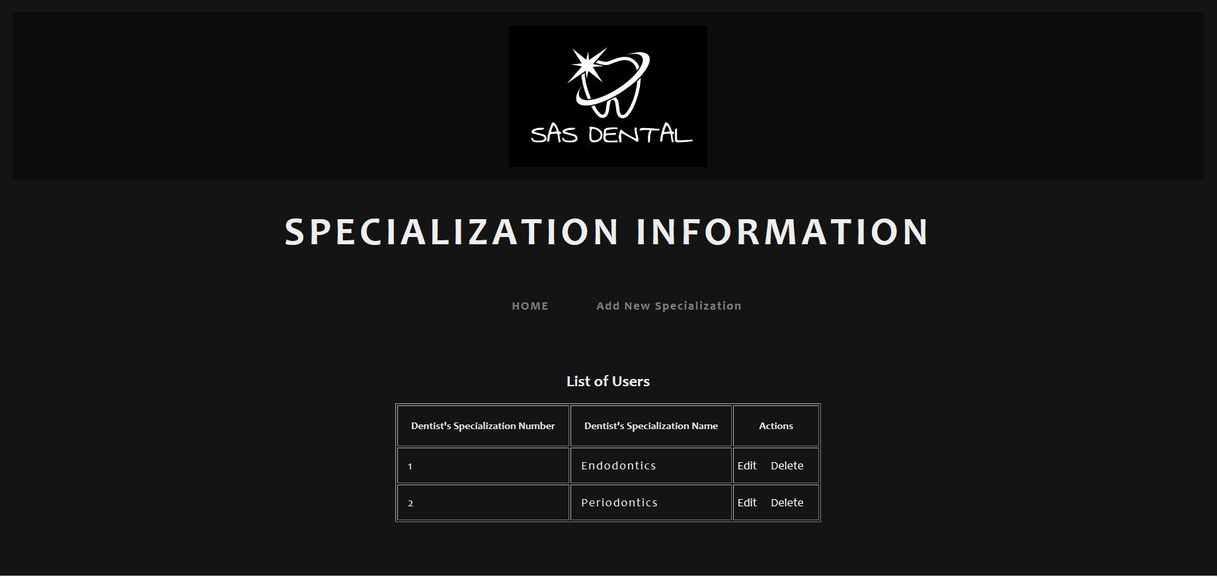

Slide 15
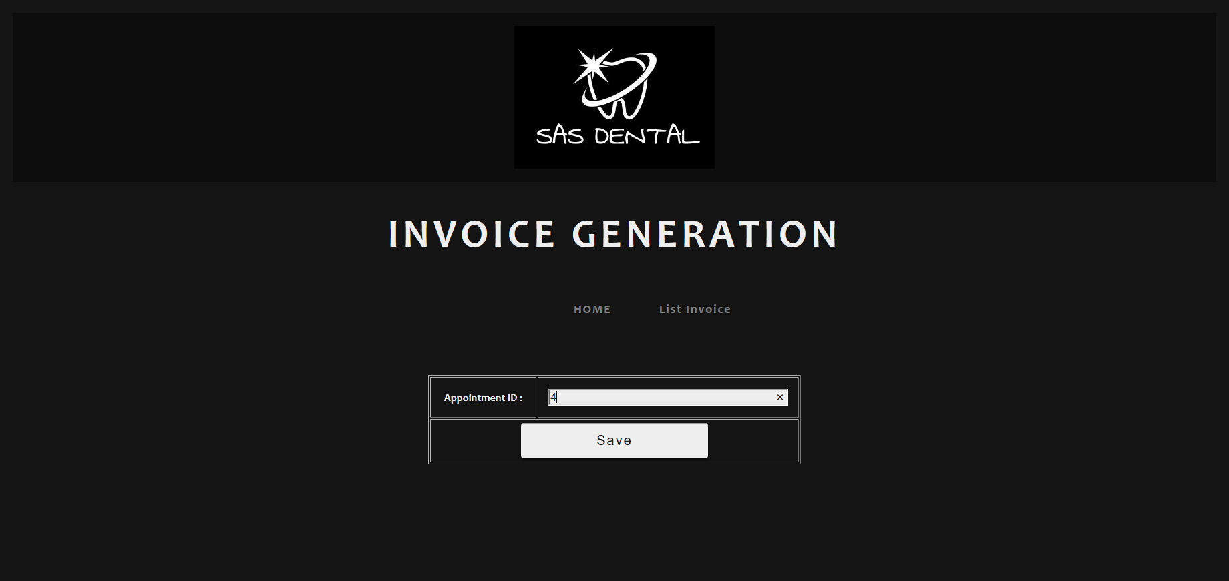

Slide 16
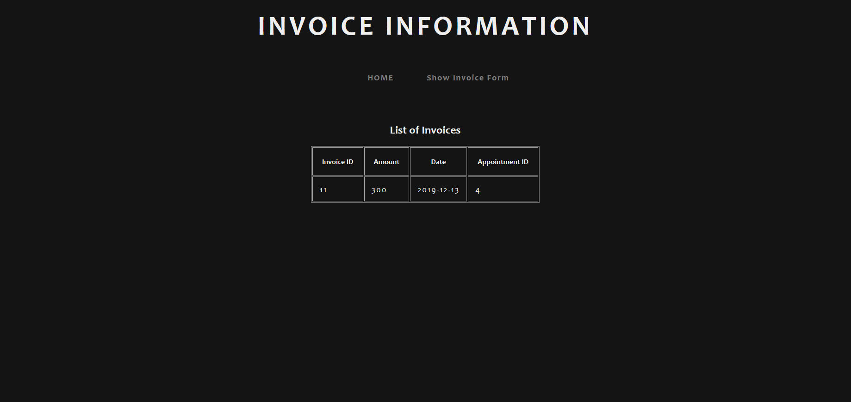

Slide 17
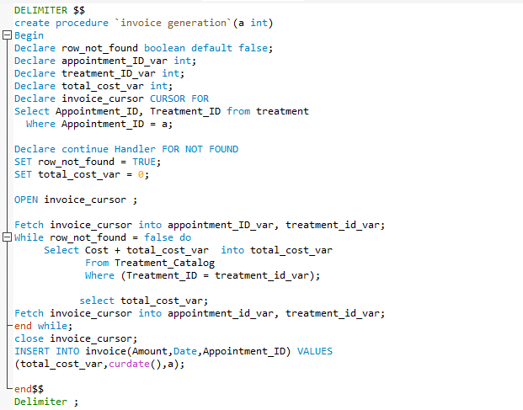
Invoice Generation Using Procedure

Slide 18
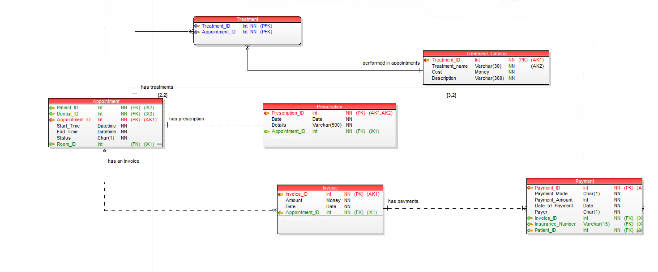
Equipment Cluster

Slide 19
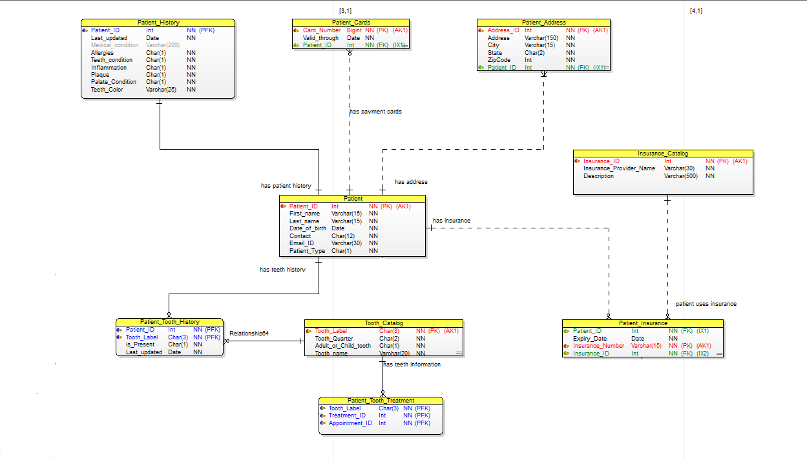
Patient Cluster

Slide 20
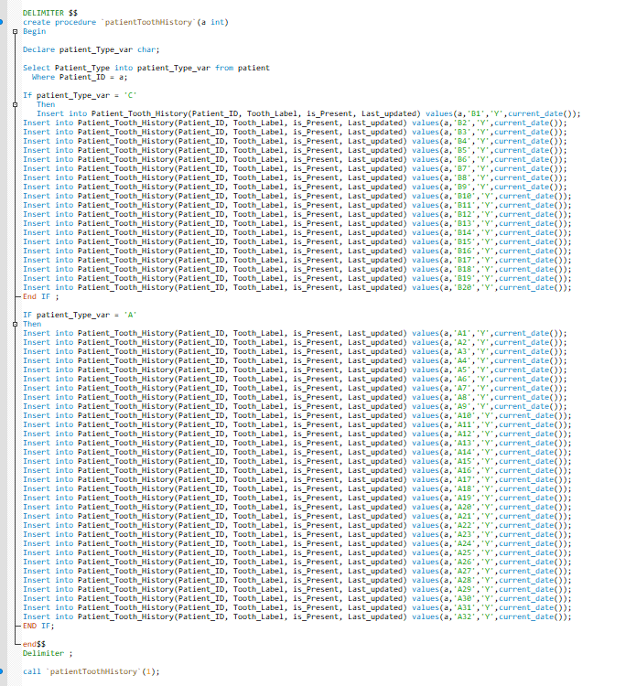
Patient_Tooth_History table initial Insertion Using Procedure

Slide 21
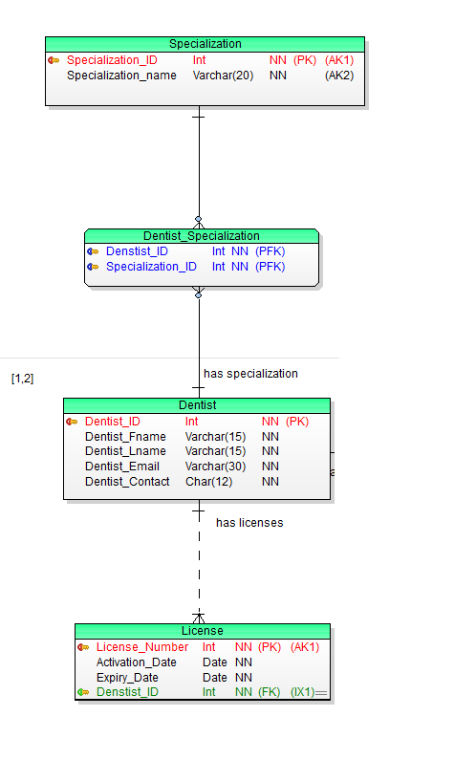
Dentist Cluster

Slide 22
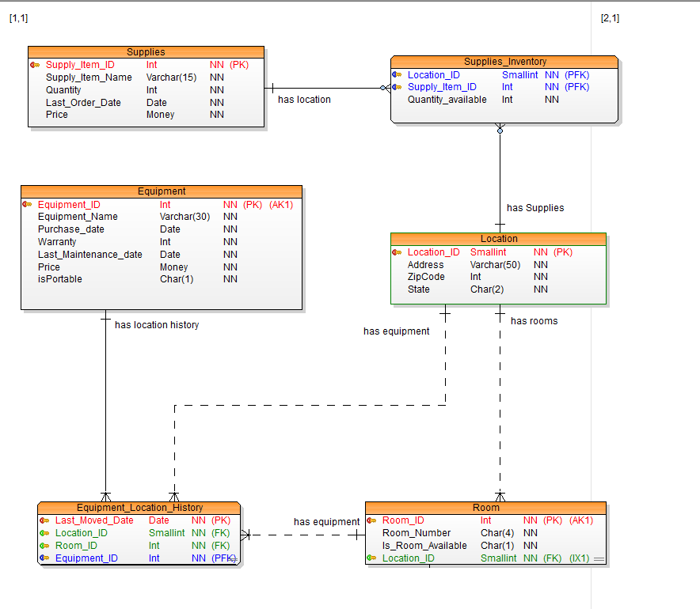
Location Cluster

Slide 23
Thank You

